Slide 1
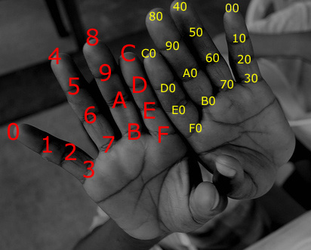
IP Addresses and Host-to-host Communication
Lecture 2
SoftUni Team
Technical Trainers
Software University
http://softuni.bg

Slide 2
Table of Contents
Binary, decimal and hexadecimal numbers
IPv4
Host-to-Host communication
Switch MAC Address table
The command line
Basic connectivity checks
Demo

Slide 3
Binary, decimal and hexadecimal numbers

Slide 4
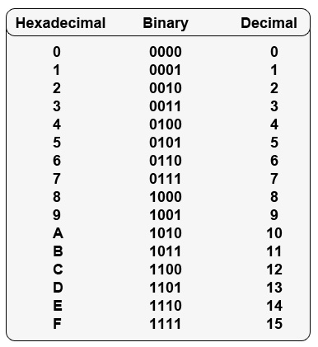
Different numeral systems
Common Numeral Systems in Computer Networking:
Decimal
Binary
Hexadecimal

Slide 5
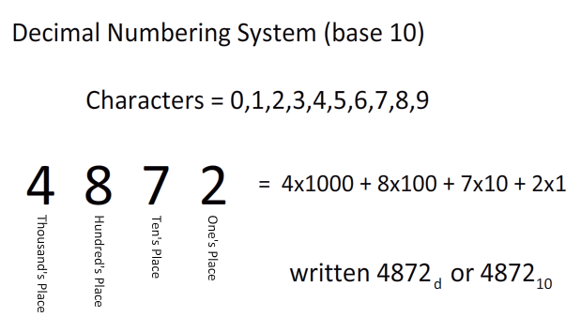
Decimal Numeral System
Base of 10
Called decimal or denary
A single digit can be: 0 1 2 3 4 5 6 7 8 9
In this example:
2x10⁰ + 7x10¹ + 8x10² + 4x10³ =
2 + 70 + 800 + 4000 = 4872

Slide 6
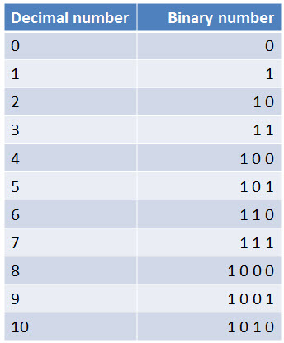
Binary Numeral System
Base of 2
Used in computers and all computer-based devices
Each digit is referred to as a bit
A single digit (bit) can be either 0 or 1

Slide 7
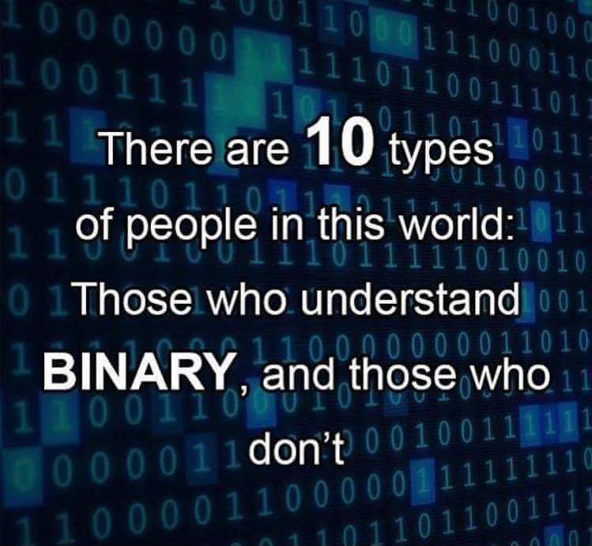
Binary joke

Slide 8
Hexadecimal numeral system
Base of 16 (made of 16 symbols)
Widely used by programmers and computer designers
Used in MAC and IPv6 addresses
A single digit can be: 0 1 2 3 4 5 6 7 8 9 A B C D E F

Slide 9
IPv4

Slide 10
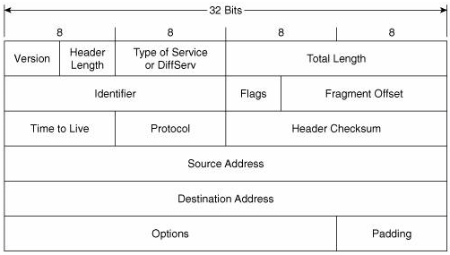
IPv4 address
Plays important role for device connectivity
It is a 32-bit address
There are 4 294 967 296 IP addresses (2³²)

Slide 11
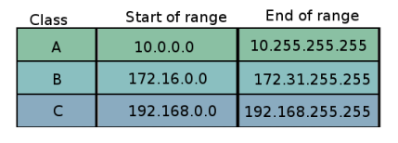
Private IP addresses
Used for addressing internal networks (offices, HQs etc.)
Not routable on the Internet
Can be reused in many networks
Range of private addresses for each class (classes are discussed later)

Slide 12
Public IP addresses
Are not reserved for use in private networks
Globally routed between ISP routers
They are unique
Example: 87.20.114.156

Slide 13
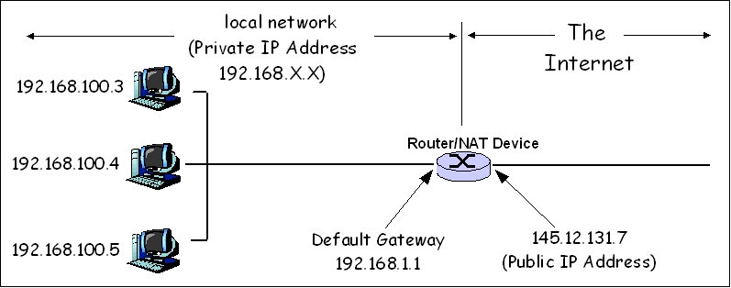
Network Address Translation – NAT

Slide 14
Network Address Translation – NAT (2)
It is a method of translating one IP address into another
Example : 192.168.17.45 ---> 227.206.89.76
Private
Public

Slide 15
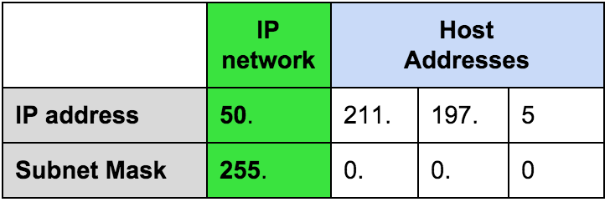
Network masks
Define the border between the network and the hosts part
Segment the network
IP address: 50.211.197.5
Subnet Mask: 255.0.0.0

Slide 16
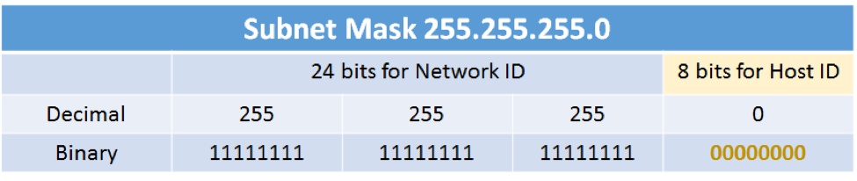
Network masks (24-bit mask)
The “subnet” part
The “host” part

Slide 17
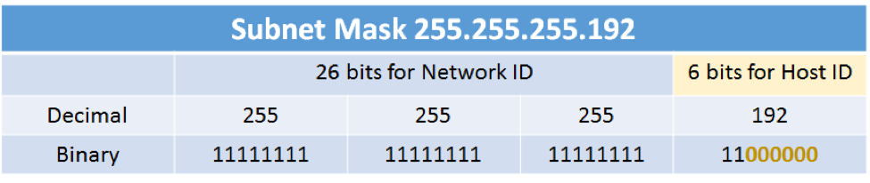
Network masks (26-bit mask)
The “subnet” part
The “host” part

Slide 18
Network masks – example 1
(Class A example)
In decimal: 255.0.0.0
Same mask written with prefix: /8
Same mask written in binary:
11111111.00000000.00000000.00000000
One byte full of 1’s. No address space
Three more bytes full of 0’s. This is 2²⁴ - 2 or 16 million computers

Slide 19
Network masks – example 2
(Class B example)
In decimal: 255.255.0.0
Same mask written with prefix: /16
Same mask written in binary:
11111111.11111111.00000000.00000000
Two bytes with 0’s. This is 2¹⁶ - 2 or 65534 computers

Slide 20
Network masks – example 3
(Class C example)
In decimal: 255.255.255.0
Same mask written with prefix: /24
Same mask written in binary:
11111111.11111111.11111111.00000000
One byte with 0’s. This is 2⁸ – 2 or 254 computers

Slide 21
Network masks – IP/Mask example
Network part
Host part
Example:
Host IP address is: 192.168.1.8
Subnet mask is: 255.255.255.0

Slide 22
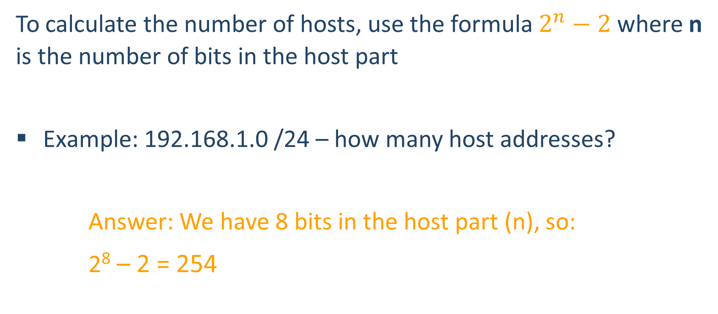
How many IP addresses for the hosts?
To calculate the number of hosts, use the formula $2^{n}−2$ where n is the number of bits in the host part
Example: 192.168.1.0 /24 – how many host addresses?
Answer: We have 8 bits in the host part (n), so:
2⁸ – 2 = 254

Slide 23
The Network and the Broadcast address
Two important and special addresses:
The network address – first possible address
The broadcast address – last possible address
These can NOT be assigned to hosts

Slide 24
The Network and the Broadcast address (2)
Example:
192.168.1.5 /24
192.168.1.5
255.255.255.0
192.168.1.0 is the network address
192.168.1.255 is the broadcast address

Slide 25
A quick challenge
10.15.1.0
Is this a valid HOST IP Address?

Slide 26
A quick challenge (2)
It depends!
Let’s see it with /23 mask. 10.15.1.0 /23 can be presented as:
First 23 bits (the “network” part)
10.15.00000001.00000000
255.255.11111110.00000000
The other 9 bits (the “host” part)
So, is it a valid host IP Address in this case?

Slide 27
A quick challenge (3)
In the example from the previous slide, which is the first and which is the last possible host address for the subnet to which this IP address belongs?
10.15.1.0 /23
10.15.0.0 is the network address
10.15.0.1 is the first host address
10.15.00000001.00000000
255.255.11111110.00000000
10.15.1.254 is the last host address
10.15.1.255 is the broadcast address

Slide 28
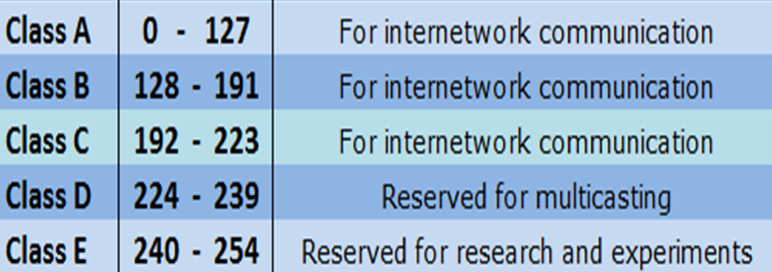
IP address classes
IP Address class is determined by the first octet (byte)
Three of them are used for addressing networks

Slide 29
IP address classes (2)
Examples of class A addresses
10.0.0.1
127.0.0.1
0.0.0.1
Examples of Class B addresses
172.16.67.8
169.254.x.x
Examples of Class C addresses
192.168.1.5
198.51.100.0

Slide 30
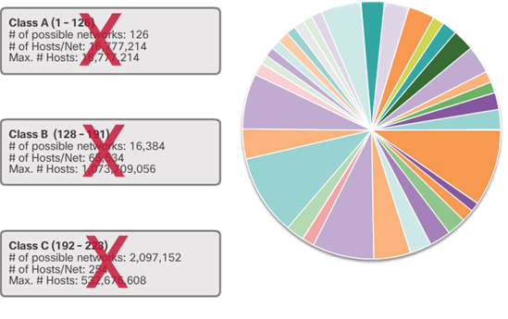
Introduction to CIDR
Ignores the concept Network Address Classes
Reduces the amount of route advertisements
Without VLSM and CIDR:
10.1.1.0 /24 will be “seen” as 10.0.0.0 /8
(because /8 is default for Class A)
With VLSM and CIDR:
10.1.1.0 /24 is “seen” as it is
(although the mask is NOT the default)

Slide 31
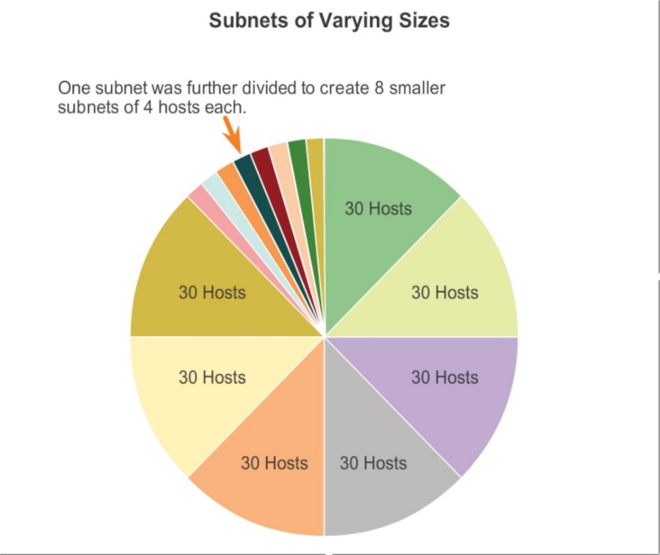
Introduction to VLSM
VLSM: Variable-Length Subnet Masking
Breaks the IP address classes idea
“Subnetting of subnets”

Slide 32
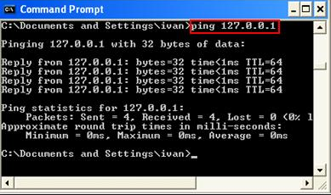
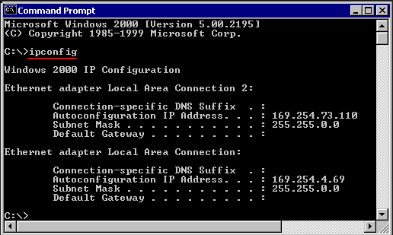
Reserved/Special IP addresses
There are some special IP addresses. For example:
127.0.0.1 /8
Known as loopback address
On most computer systems, “localhost” resolves to the IP address 127.0.0.1
169.254.X.X /16
When DHCP is not reachable
Known as APIPA (Microsoft)

Slide 33
Host-to-host communication

Slide 34
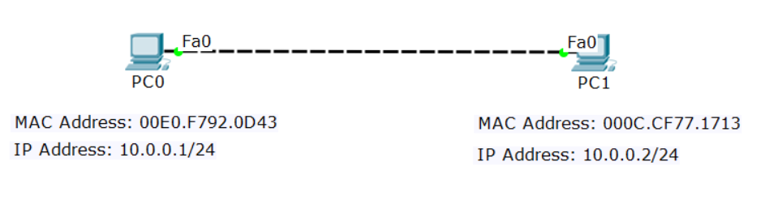
Four addresses required
There are 4 addresses needed for Ethernet communication:
Source IP | Destination IP
Source MAC | Destination MAC

Slide 35
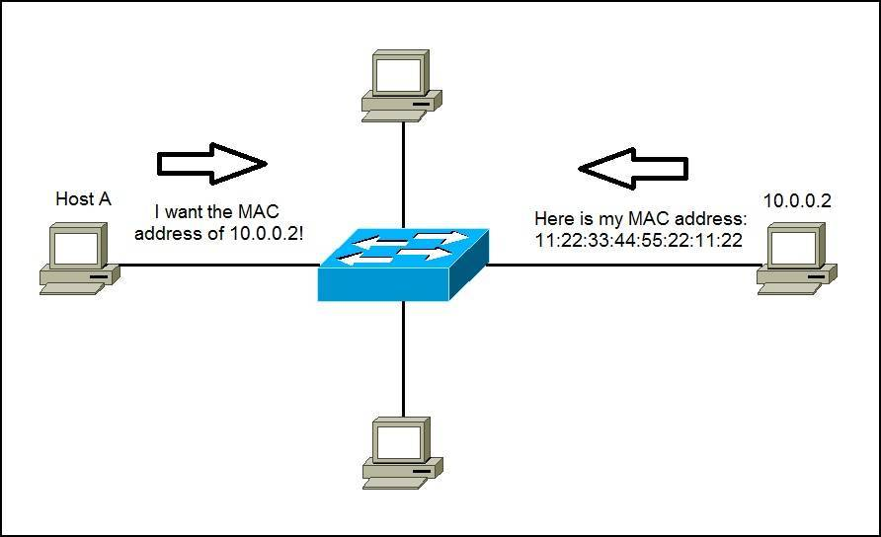
ARP: Address Resolution Protocol
Used to find the MAC address of the destination
Uses Broadcast

Slide 36
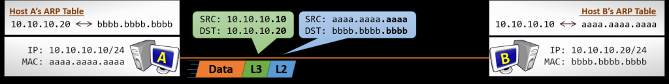
Direct communication (without router)
Source and destination MAC addresses are constant
Source and destination IP addresses are constant

Slide 37
Host-to-host communication with routers
Source and destination MAC addresses are changed at every hop (router)
Source and destination IP addresses are constant (if we do not use NAT)

Slide 38
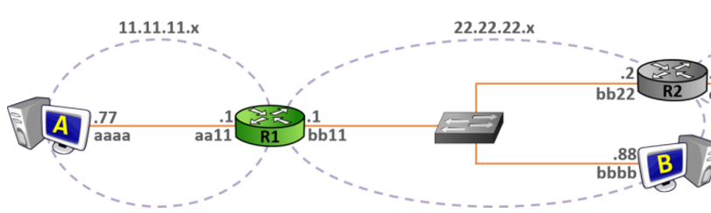
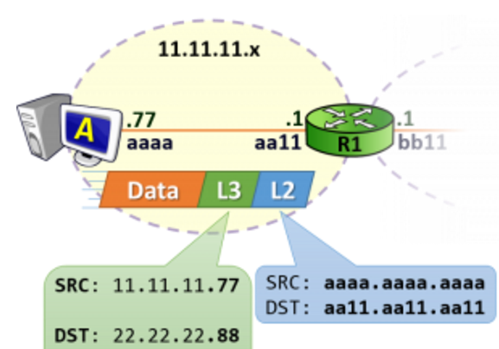
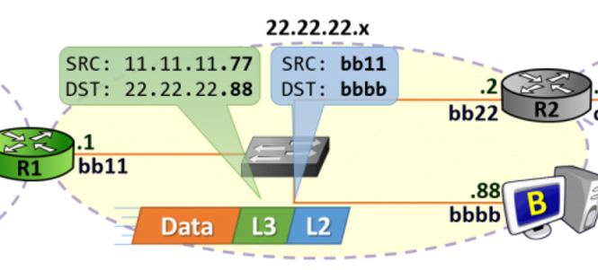
Host-to-host communication with routers (2)

Slide 39
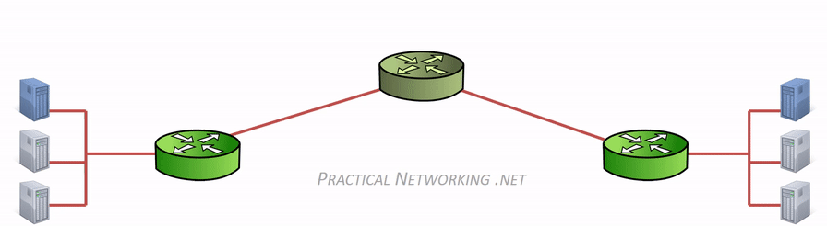
Host-to-host communication with routers (3)
Source and destination MAC addresses are changed at every hop/router

Slide 40
Switch MAC address table

Slide 41
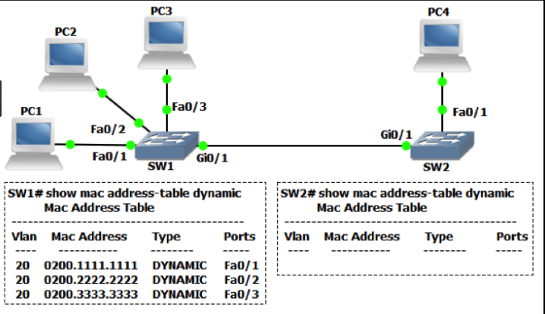
The MAC address table
It is a (dynamic) table that maps MAC addresses to ports
Used to find the proper interface when the switch forwards a packet

Slide 42
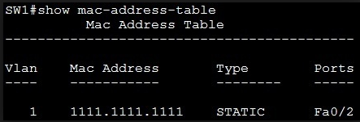
The MAC address table (2)
You can assign MAC Address statically as well
Pros: It is more secure
Cons: It is bit slower and harder for sysadmin to assign it manually

Slide 43
The command line

Slide 44
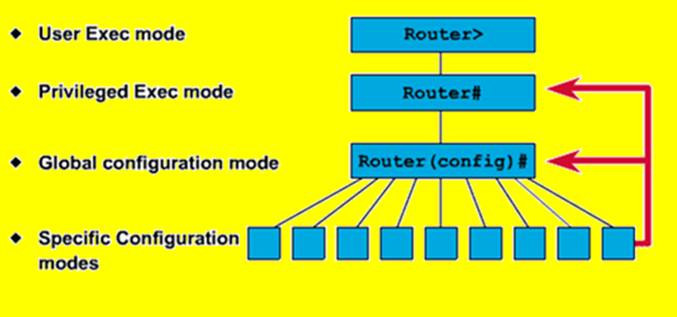
Command line introduction
Different vendors use different names but the logic is similar
Typical CLI modes:
Read-only (User)
Read-write (Privilege)
Configuration (Global config)
Sub-configuration

Slide 45
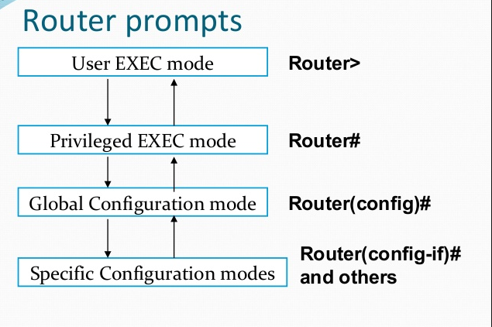
Command line
type “enable”
type “configure terminal”
Interface, VLAN, routing, etc.
to go back, type “exit”

Slide 46
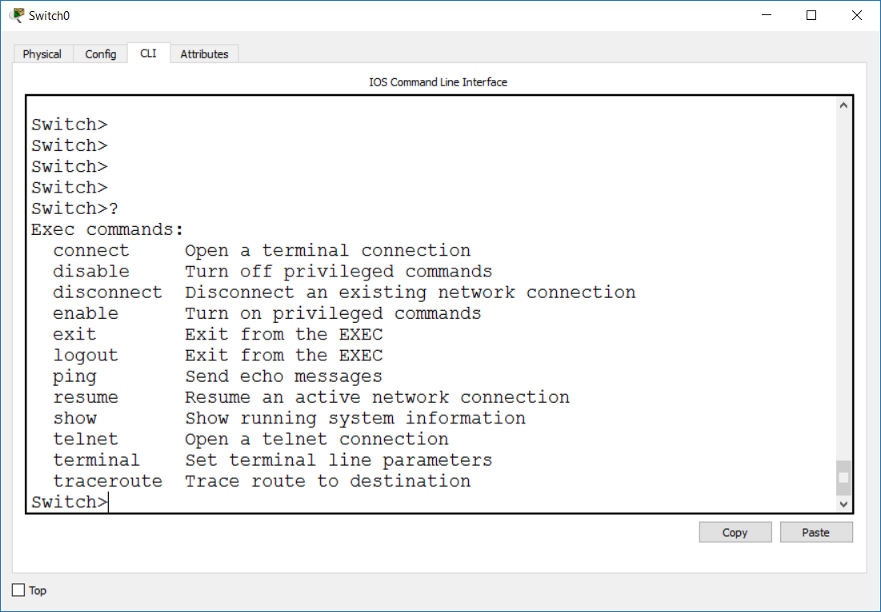
Using the help – “?”
Use the “?” at each level to see the available commands

Slide 47
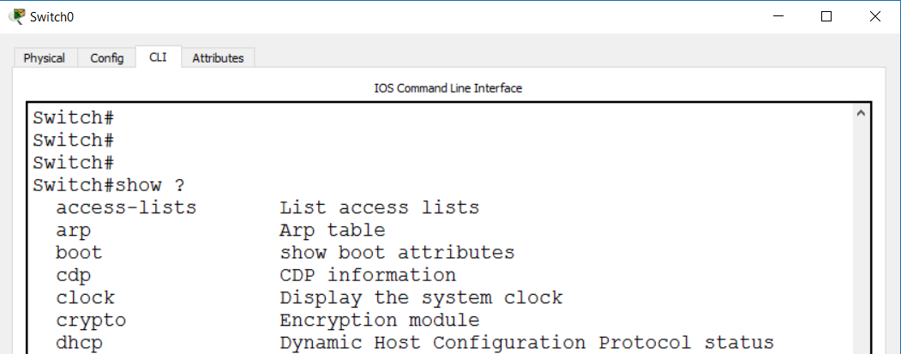
Using the help – “?” (2)
Use the “?” as you type to see:
how to finish a command
what is/are the next word in the command

Slide 48
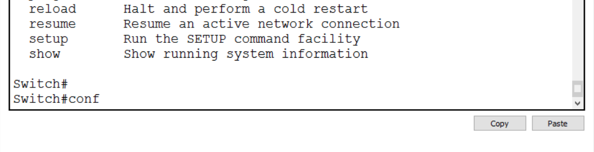
Using the help – TAB
Hit the TAB key here to autocomplete “configure”

Slide 49
Basic connectivity checks

Slide 50
Basic Connectivity Checks
Ping (Layer 3)
Traceroute (Layer 3)
LLDP (Layer 2)
CDP (Layer 2)

Slide 51
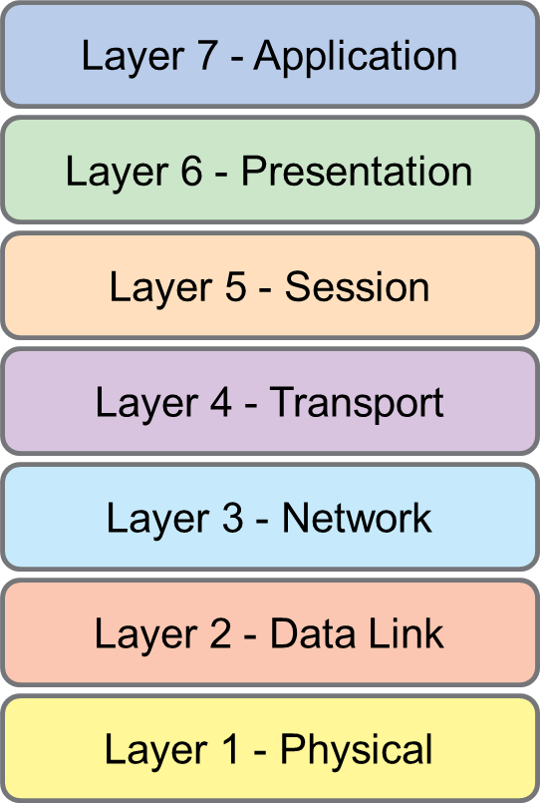
Ping
Important Layer 3 connectivity check
Must have IP addresses
ICMP echo request and ICMP echo reply
PING (and traceroute)

Slide 52
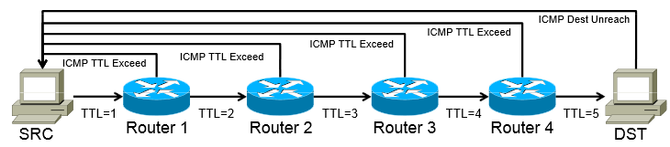
Traceroute
Another L3 connectivity check
Uses the TTL (Time to Live) value in the packet
Can determine the number of hops (routers) in the path

Slide 53
LLDP: Link Layer Discovery Protocol
Who is connected to me?
Works at Layer 2
Must be enabled on both sides
Vendor-neutral
LLDP (and CDP)

Slide 54
LLDP (2)
Gathered information with LLDP:
System name and description
Port name and description
VLAN name
IP management address
System capabilities (switching, routing, etc.)
MAC/PHY information
MDI power
Link aggregation

Slide 55
CDP: Cisco Discovery Protocol
Cisco proprietary
Gathers info about other Cisco (CDP) neighbor devices
Operates at L2
Turned on default by all Cisco switches and routers

Slide 56
Demonstration

Slide 57

Summary
Binary, decimal and hexadecimal numbers
IPv4
Host-to-Host communication
Switch MAC Address table
The command line
Basic connectivity checks
…
…
…

Slide 59












SoftUni Diamond Partners

Slide 60


Educational Partners

Slide 61
Trainings @ Software University (SoftUni)
Software University – High-Quality Education, Profession and Job for Software Developers
softuni.bg, about.softuni.bg
Software University Foundation
softuni.foundation
Software University @ Facebook
facebook.com/SoftwareUniversity
Software University Forums
forum.softuni.bg
Notes:
61

